Slide 1
HSW Moment
Sun / Heat Stress Awareness

Slide 2

UV – Awareness (Ultraviolet Radiation)
Sun and Heat Facts
UV radiation from the sun is the major cause of skin cancer.
Globally there are over 324,000 cases of skin cancer every year (UK over 16,000), resulting in over 57,000 deaths (and rising every year).
Employees working outside should consider exposure to UV radiation as an occupational health hazard.
Getting sunburnt just once every two years can triple your risk of melanoma skin cancer, compared to never being burnt.
Driving in hot weather can be draining; it is easy to lose concentration, especially if you are driving for long periods.
What is Heat Illness?
Heat illness is caused by a rise in body temperature and is often referred to as heat stress, heat stroke, or heat exhaustion.
Excess UV can also cause sun burn which can lead to increased risk of skin damage and skin cancers.
Heat Stress Symptoms:
headache
dizziness
light-headedness
fainting
weakness
moist skin
mood changes
irritability
confusion
nausea, vomiting
Rapid breathing
Rapid pulse rate

Slide 3













Heat Stress Awareness
HEAT RELATED ILLNESSES TO WATCH OUT FOR
SYMPTOMS OF HEAT RELATED ILLNESSES
When heat gain exceeds the ability of the body to compensate, heat illnesses can result.
Heat stress disorders range from minor discomforts to life threatening conditions
Feeling Weak and Fatigued
Headache
Loss of Concentration, Confusion • and Irritability.
Nausea and Vomiting
Rapid Breathing and Shortness of Breath
Fast, Weak Pulse Rate or Palpitations
Tingling/ Numbness of fingers toes
Visual Disturbance
Dizziness and Fainting
Seizures and Unconsciousness
Clumsiness, Slower Reaction Times
Slurred Speech
Intense Thirst
Heavy Sweating
Red, Hot and Dry skin with no sweating
It’s important that, we all know how to Identify, Treat and Prevent these illnesses.
Less severe
Heat Rash
Heat Cramps
Heat Syncope (fainting)
Heat Exhaustion–Ifuntreated, can quickly lead to heat stroke
Heat Stroke – If untreated by medical care, can result in death
More severe

Slide 4
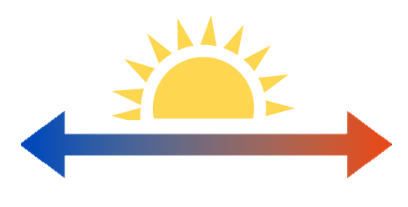
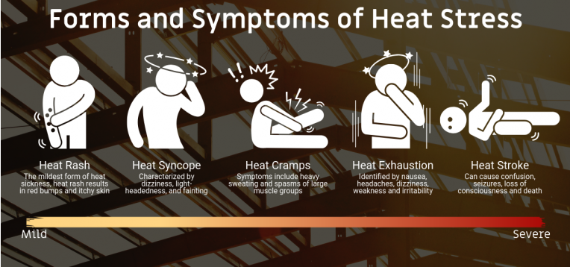
Heat Stress Related Illness
Less severe
The term heat-related illnesses describes a range of progressive heat-related conditions:
More severe
It’s important that we all know how to identify, treat and prevent these illnesses.

Slide 5


Heat Illness & Symptoms
Heat Rash is a skin irritation caused by excessive
sweating during hot, humid weather.
Heat Rash
Illness | Symptoms | Recommended Actions
Heat rash | Looks like a red cluster of pimples or small blisters | Work in a cooler, less humid environment when possible Keep the affected area dry May use dusting powder to increase comfort

Slide 6
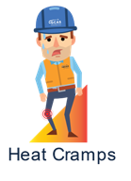
Heat Stress Related Illness
Heat Cramps usually affect employees who sweat a lot. This sweating depletes the body’s salt and moisture levels. Low salt levels in muscles causes painful cramps. Heat cramps may also be a symptom of heat exhaustion
Heat
Cramps
Heat Cramps
Illness | Symptoms | Recommended Actions
Heat Cramps | Muscle pain or spasms usually in the abdomen, arms or legs | Stop all activity and sit in a cool place Drink clear juice or a sports beverage Do not return to strenuous work for few hours Seek Medical Attention if: Employee has heart problems Employee is on low- sodium diet Cramps do not subside within one hour

Slide 7
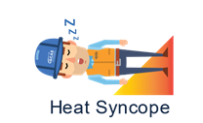
Heat Stress Related Illness
Heat Syncope is a fainting episode or dizziness that usually occurs with prolonged standing or sudden rising from a sitting or lying position. Factors that contribute to heat syncope include dehydration and lack of acclimatization
Heat
Cramps
Heat Syncope
Illness | Symptoms | Recommended Actions
Heat Syncope | Light-headedness Dizziness Fainting | Sit or lie down in a cool place when they begin to feel the symptoms Slowly drink water, clear juice or sports beverage

Slide 8

Heat Stress Related Illness
Heat Exhaustion is the body’s response to an excessive loss of the water and salt, usually through excessive sweating.
Heat
Cramps
Heat Exhaustion
Illness | Symptoms | Recommended Actions
Heat Exhaustion | Heavy sweating Extreme weakness or fatigue Nausea Pale and flushed complexion Muscle cramps Slightly elevated body temperature Fast and shallow breathing | First Aid. This condition can lead to heat stroke, which can kill. Have them rest in a cool, shaded or air-conditioned area Have them drink plenty of water or other cool, nonalcoholic beverages Have them take a cool shower, bath or sponge bath

Slide 9

Heat Stress Related Illness
Heat Stroke is the most serious heat-related disorder.
Unable to control body temperature (40℃)
Body’s temperature rises rapidly
Sweating mechanism fails
Body is unable to cool down
Heat Stroke can cause death or permanent disability if emergency treatment is not given
Heat Stroke
Illness | Symptoms | Recommended Actions
Heat Stroke | Hot, dry skin or profuse sweating Hallucinations Chills Throbbing headache High body temperature Confusion/dizziness Slurred speech | Call emergency contact and notify supervisor Move the sick employees to a cool shaded area Cool the employee using methods such as: Soaking their clothes with water Spraying, sponging or showering them with water Fanning their body

Slide 10
Preventing Heat Illness and Sunburn
Sun safety code
Take care not to burn; it can take as little as 10 minutes.
Cover up with loose clothing, ensure unprotected skin covered.
Wear a wide brimmed hat or a safety helmet with a hanging flap which protects the back of the neck.
Wash frequently to remove sweat.
Seek shade during hottest part of the day, take breaks in the shade.
Drink plenty of water frequently; in high heat drink 1 cup of water every 15 minutes.
Apply high factor sunscreen generously and frequently to any parts of the body exposed to the sun; ≥SPF 30 (UVA and UVB).
Regularly check skin, look for any changed or newly formed moles or skin discolorations, especially around the nose, eyes, or on backs of hands. Consult a doctor if any moles grow, change or start to bleed.
When driving in hot weather:
switch aircon on
park in shaded areas
use a sun shield over the windscreen
cover metal parts of seat restraints to keep them from becoming too hot
keep a container of water
take regular breaks to maintain concentration levels
carry moist wipes

Slide 11

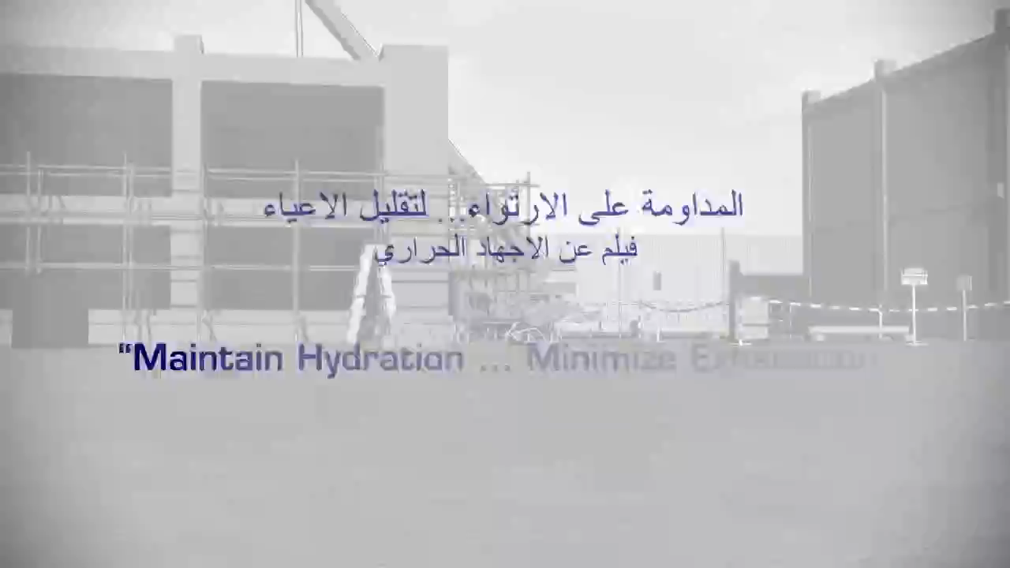
Summer Working Guidelines – Videos

