Slide 1
HSW Moment
Summer(holiday) Activity Safety Awareness

Slide 2


Introduction
While summer activities are enjoyable, like any other activities, they come with health and safety risks.
Engaging in outdoor pursuits such as swimming and playing sports brings with it the possibility of accidents, injuries, and health issues.
Water-related activities, although fun, carry the danger of drowning or waterborne illnesses.
It is important that these risks are considered so that everyone can enjoy the summer season safely.

Slide 3



Jet Lag and Fatigue
Potential Dangers:
Disrupted sleep
Impaired concentration
Headaches
Prevention Tips:
Gradually adjust sleep schedule before travel.
Stay hydrated and avoid alcohol and caffeine during flights.
Get plenty of rest upon arrival.
Jet lag occurs when a person's internal body clock is out of sync with the time zone they have travelled to. It is especially common when crossing multiple time zones quickly, such as on long-haul flights.

Slide 4

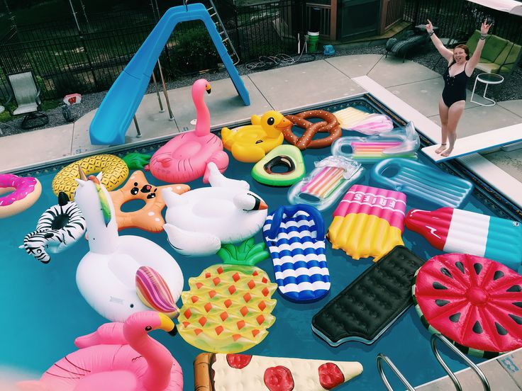
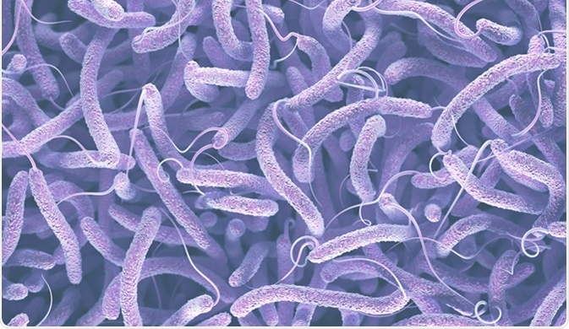
Swimming Pools
Prevention Tips:
Take swimming lessons and use flotation devices/life jackets if necessary
Avoid swallowing pool water
Shower before and after swimming.
Use sun protection cream
Use swimming glasses
Don’t drink alcohol in the pool.
Don’t run
Jump only in defined area.
Potential Dangers:
Drowning risks
Waterborne illnesses e.g. e. coli, Legionella
Chemical exposure
Slip, trip and falls
Alcohol consumption
Eye irritation
Swimming pools are popular during the summer for both relaxation and exercise. However, they come with potential dangers.

Slide 5

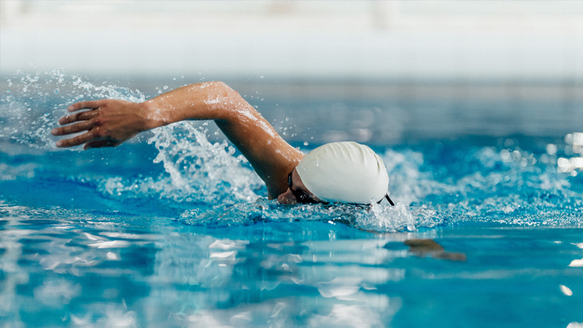
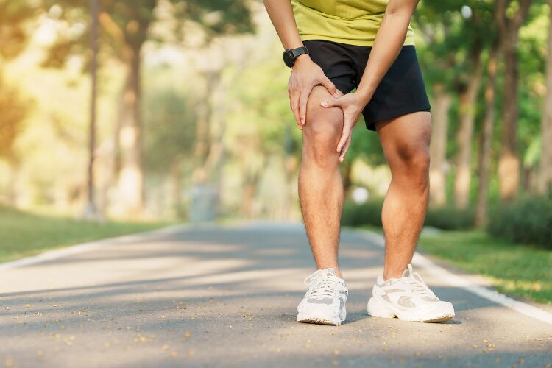
Sports and Physical Activities
Potential Dangers:
Sprains
Fractures
Concussions
Prevention Tips:
Use proper equipment and protective gear.
Warm up before activities and cool down afterwards.
Follow rules and guidelines for each activity.
Monitor children
No alcohol before exercise
Medical insurance.
Engaging in sports during the summer is a great way to stay active but can pose several risks, particularly in hot weather.

Slide 6
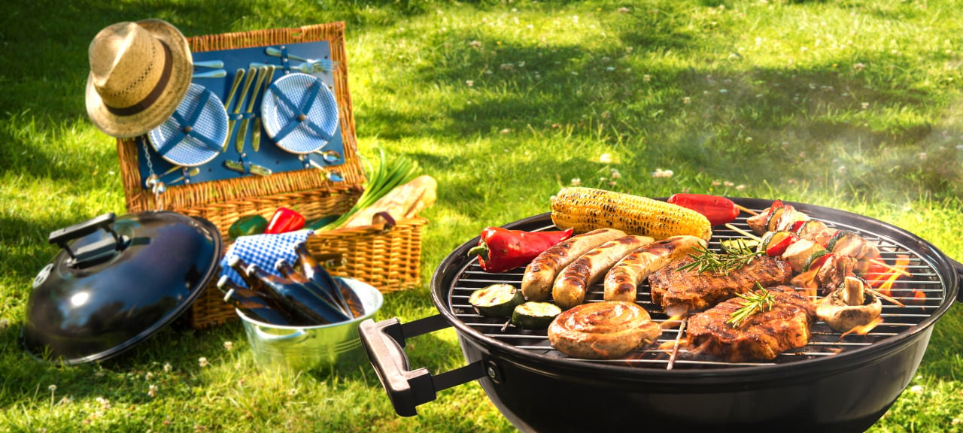

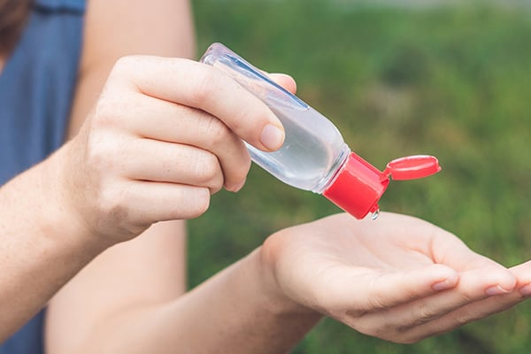
Barbecues and Picnics
Potential Dangers:
Food poisoning
Burns
Insect bites and stings
Tick bites(Lyme disease)
Fire
Prevention Tips:
Keep perishable foods refrigerated.
Cook meat to proper temperatures using appropriate caution.
Practice good hygiene and handwashing.
Use safe grill fireplace
Use insect repellent.
Barbecues and picnics are enjoyable summer activities but come with specific health and safety risks.

