Slide 1
HSW Moment
Mental Health Movement
May 2024

Slide 2
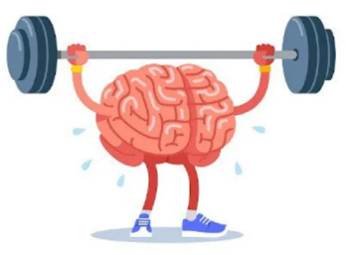
The Mental Health Benefits of Physical Activity
It's a scientific fact that regular physical activity and exercise can make us healthier and happier.
When we're active, the body releases feel-good hormones, such as endorphin and serotonin, that can improve our mood and boost our energy.

Slide 3
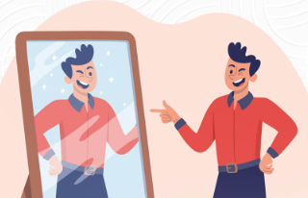
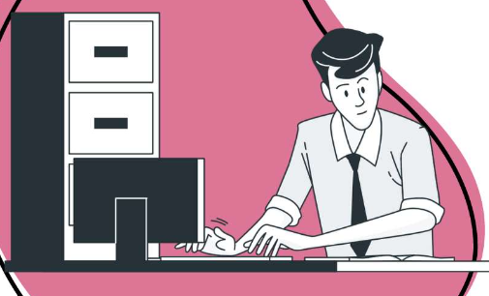
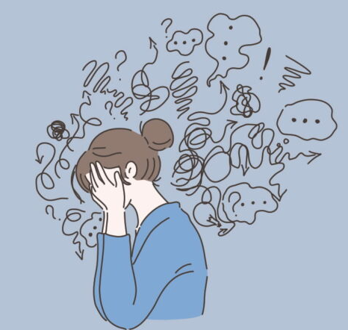
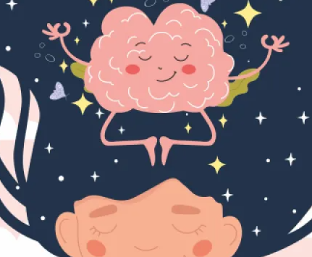
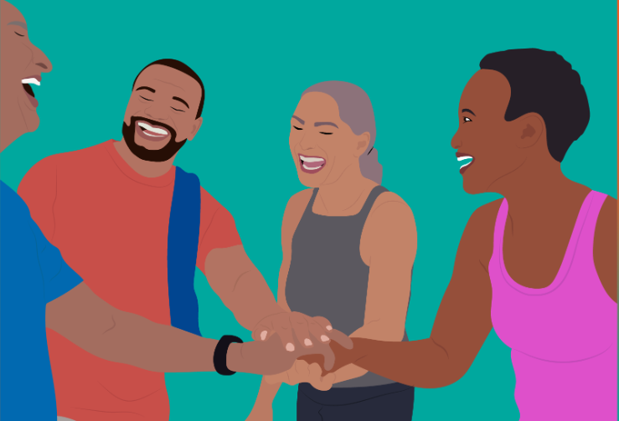
The Mental Health Benefits of Physical Activity
Some of the benefits of exercise for mental health include:
Boosting our self-esteem and confidence
Increasing motivation and focus
Reducing tension, anxiety, stress and mental fatigue
Helping to calm the mind, especially when dealing with difficult emotions like anger, frustration and sadness
Reducing loneliness by offering new ways to get together with family and friends, and meet new people

Slide 4
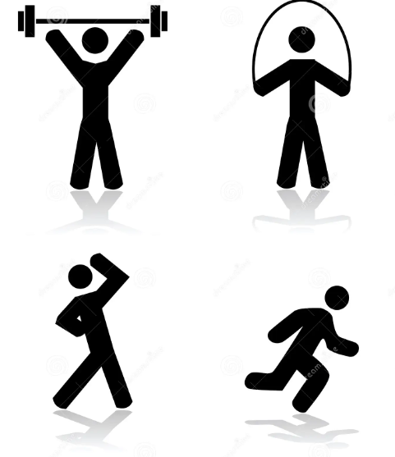
How active do I have to be?
Any amount of physical activity is good for you, so do not worry if you need to start off easy.
The most important thing is to do something you enjoy, as you're more likely to keep doing it.
Adults should aim for about 150 minutes of moderate activity each week, which should include something for muscle strength. This could be anything from carrying shopping to lifting weights at home or at the gym – just make sure any weight you use is right for you.
Once you're regularly active try thinking about increasing the amount of activity you do, remember that some is good, more is better.

Slide 5
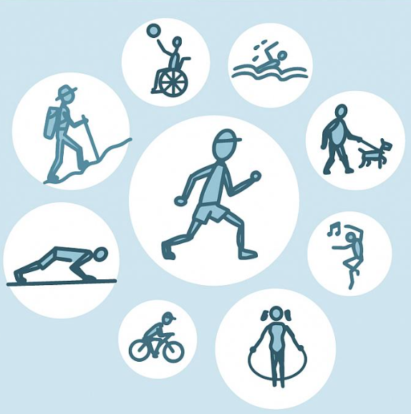
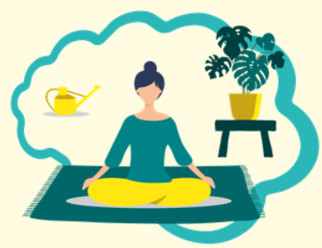
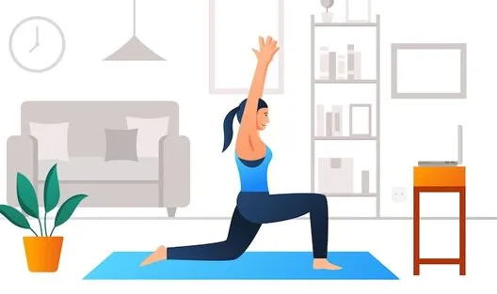
Ways to be active for your mental health
Move at your own pace
There are lots of ways to be active – and you do not need to be an athlete. Find ways to move that you enjoy and that fit in with your daily routine, health and lifestyle.
Think about what might help you, as different activities might result in different benefits. For example, yoga can be good for dealing with anxiety, and running might help with managing stress.
There's lots of stuff you can do that's quick and needs no equipment. If you just want to try something new at home, there are many free online classes available.

Slide 6

Ways to be active for your mental health
Keep going
Setting goals can help with motivating us to stay active. For example, use a pedometer to check how many steps you're doing each day and then set a higher goal for the following week.
Be realistic about your goals. Setting yourself a tough target that's hard to achieve might make it tempting to give up. Set small, achievable goals that you can increase at your own pace over time. And celebrate achieving each goal you set yourself.
If you do stop, do not give up. See a break as a chance to think about what works for you and get moving again. Perhaps try something different that you find more enjoyable.

Slide 7
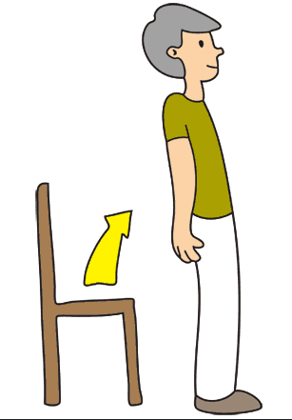
Ways to be active for your mental health
Take a break from sitting
Many of us are sitting for long periods during the day: working at desks, driving, sitting down to browse the internet or scroll through social media, watching our favourite television show or reading a book.
Research shows that it’s unhealthy to be sitting or not moving for long. If you are sitting for large periods of time throughout the day, set a timer to take regular breaks to stand up, walk around and stretch your body.

Slide 8
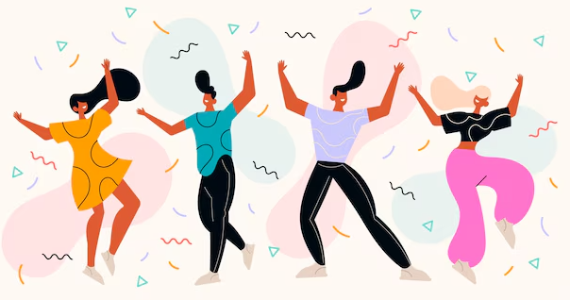
Ways to be active for your mental health
Find the fun
However you choose to get moving, the best option is usually the one we enjoy the most.

Slide 9
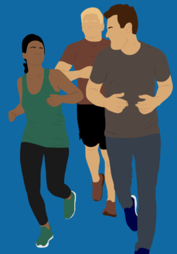
Ways to be active for your mental health
Connect with others
We can strengthen our personal relationships or even make new friends when we take part in movement activities with other people. These social connections are also great for our mental health and wellbeing.
Think about ways you can make your catch-ups with friends more active. Maybe, instead of meeting in a coffee shop, get your coffee to go and take a walk at your comfortable pace. Or visit your local pool and chat while having a swim.
You could also use opportunities for movement to meet new people. Check out what groups and activities are taking place in your area and sign up to join in. Being part of a club or team is a great way to increase your self-esteem and help reduce feelings of depression, stress, and anxiety.

Slide 10
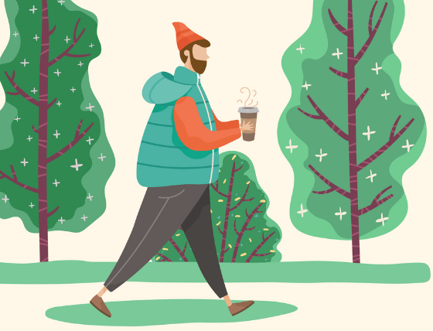
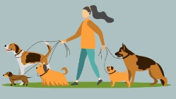
Ways to be active for your mental health
Moving in nature
Research suggests that doing movement in an outdoor ‘green’ environment has greater positive effects on our wellbeing compared to doing activity indoors. So why not take your moments for movement out in the wild? Go for a walk in the countryside or perhaps try cold water swimming at the beach.
Even if you live in the city, nature is often close by. Parks, gardens, nature reserves, forests, all provide opportunities for exercise, movement and meeting new people. You could find opportunities to get moving such as a walking group, gardening club, or volunteering for woodland and park maintenance.

Slide 11
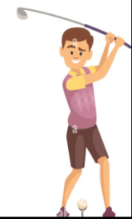
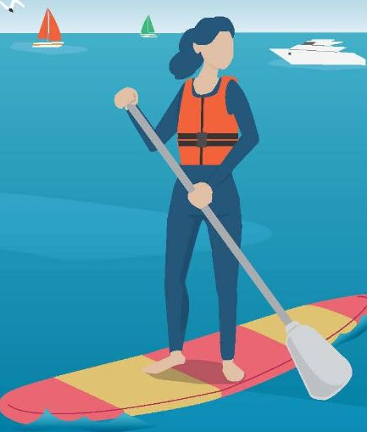
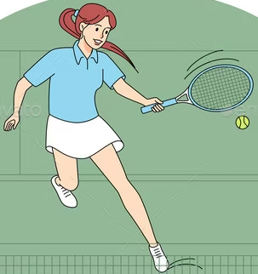
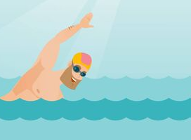
Ways to be active for your mental health
Try something new
When we are open to trying new experiences, we reap the rewards to our wellbeing. You might be inspired by watching Strictly Come Dancing but have been too shy to try your local dance classes. Give it a whirl! Pushing ourselves to try new things opens us up to new opportunities for movement, making new friends and having fun.
Having the courage to try something new will also give your confidence a boost. If you don’t try, you’ll never know!

Slide 12

Ways to be active for your mental health
Listen to music that gets you moving
Some songs are just made for moving. We all have favourite tunes that get us on the dance floor. So, crank them up and have a living room disco where you can dance like no-one’s watching!
Why not play your favourite song when you get up in the morning, dance around and put yourself in a good mood for the day ahead?

Slide 13

Ways to be active for your mental health
Celebrate your achievements
Well done! Congratulate yourself for taking care of your body and mind. Make sure to reward yourself too, perhaps a nice bubble bath after a walk in the park or something else that you enjoy.
Appreciation is a powerful way of generating positive thoughts and feelings. Recognising our progress is an important part of moving for our mental health!

Slide 14

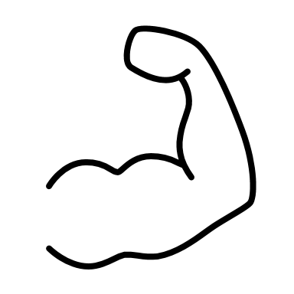


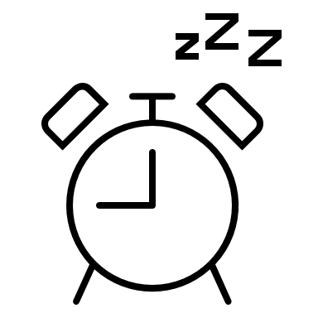
Fun facts about exercise
Music improves workout performance
More muscle mass = burning more fat while resting
Exercise prevents signs of aging
You get sick less often
Working out enables you to sleep better

Slide 15
Do you move/exercise periodically?
How often do you move/exercise?
Do you feel an improvement on your mental health?

