Slide 1

Time to talk - May
Wellbeing Check-in
Moving More for Mental health
Exploring Vulnerability for Men
Movement Calendar

Slide 2
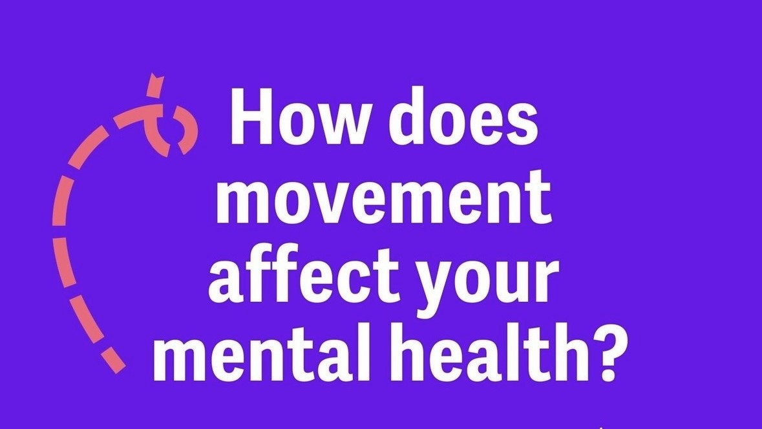
Notes:
We know that even the thought of starting “exercise” can be off-putting to many people and that’s why this years theme is focusing on movement that make you feel good. At a very basic level, physical activity means any movement of your body that uses your muscles and expends energy. One of the great things about moving more is that there are possibilities to suit almost everyone.
Benefits of movement for mental health range from improved mood, reduced anxiety, lowered inflammation and stress, improved memory and concentration, increased confidence, improved sleep and even increased social connectedness.

Slide 3
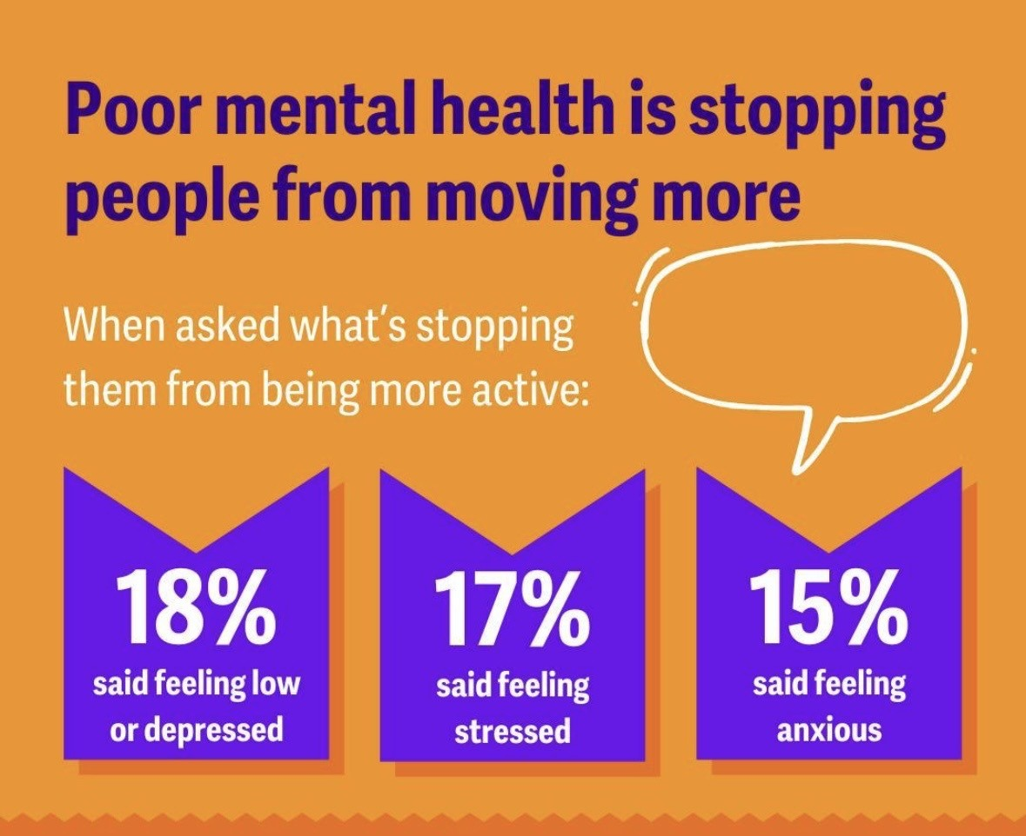
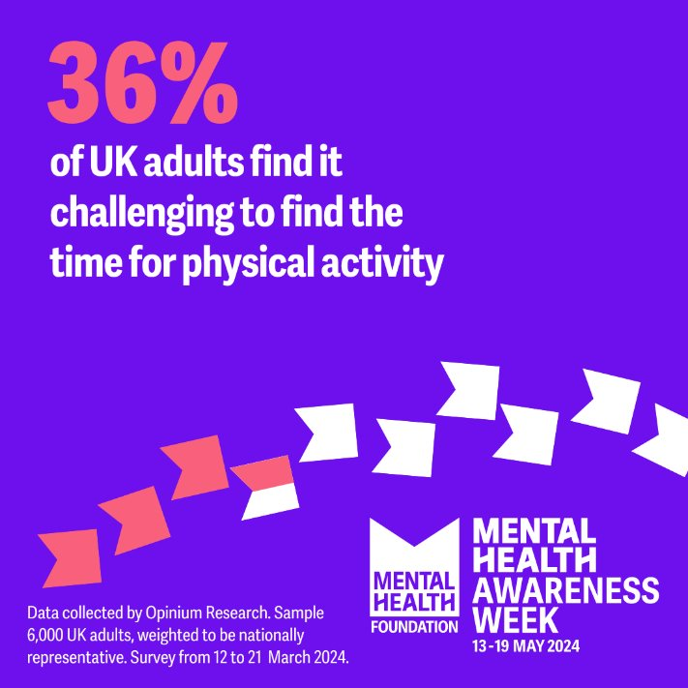
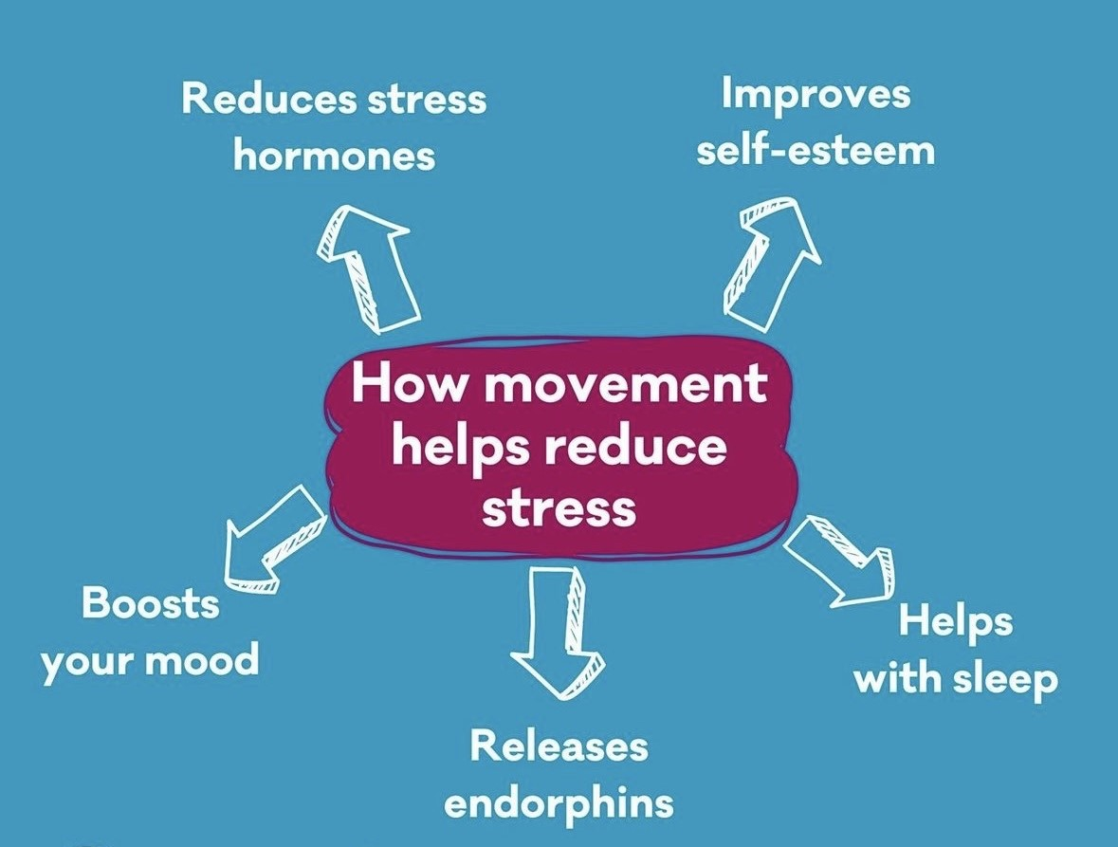
Notes:
6000 adults across the UK were polled and conducted focus groups so we could speak directly to people who live at an increased risk of poor mental health. This included parents, young people, asylum seekers and refugees, and people living with long term health conditions. This was done to better understand the barriers to movement and, in turn, the barriers to one of the most powerful actions available to us to protect our mental health.
We Sarah with us today who would like to share a personal story of how they got into health and fitness.

Slide 4
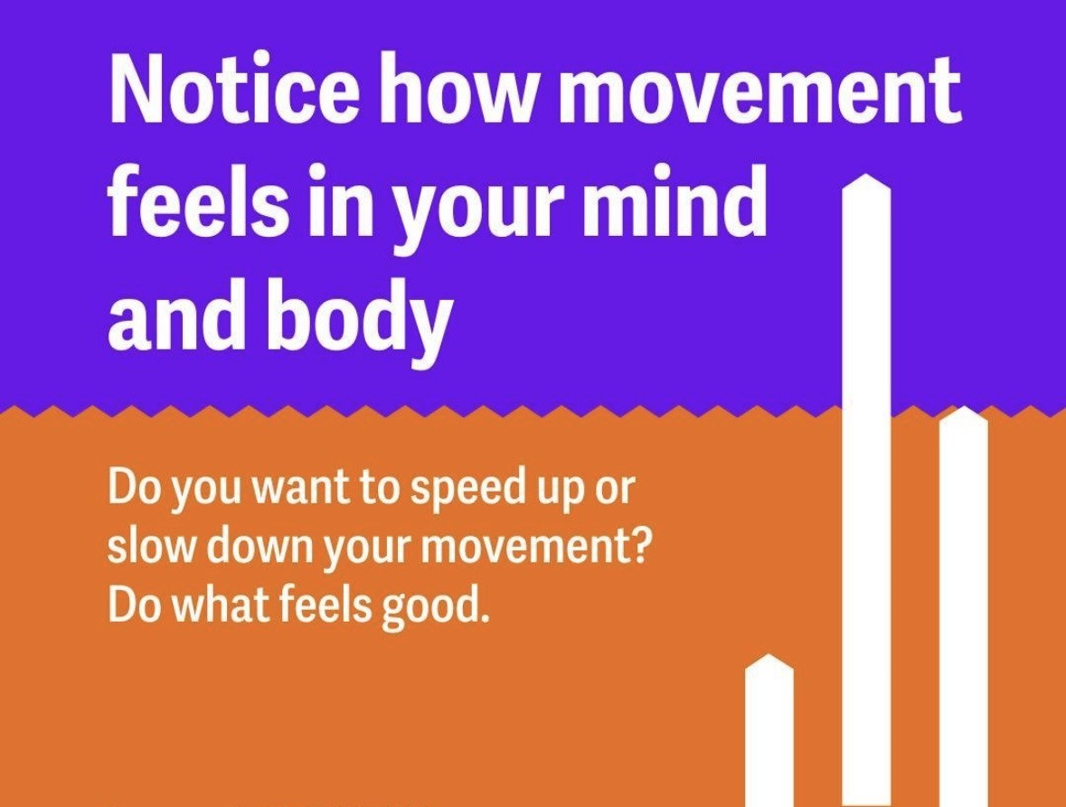
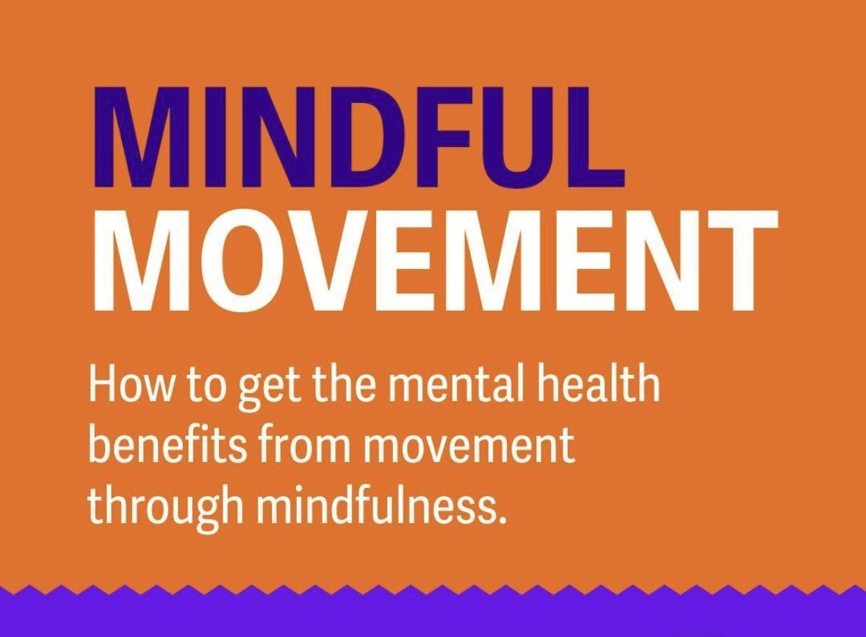
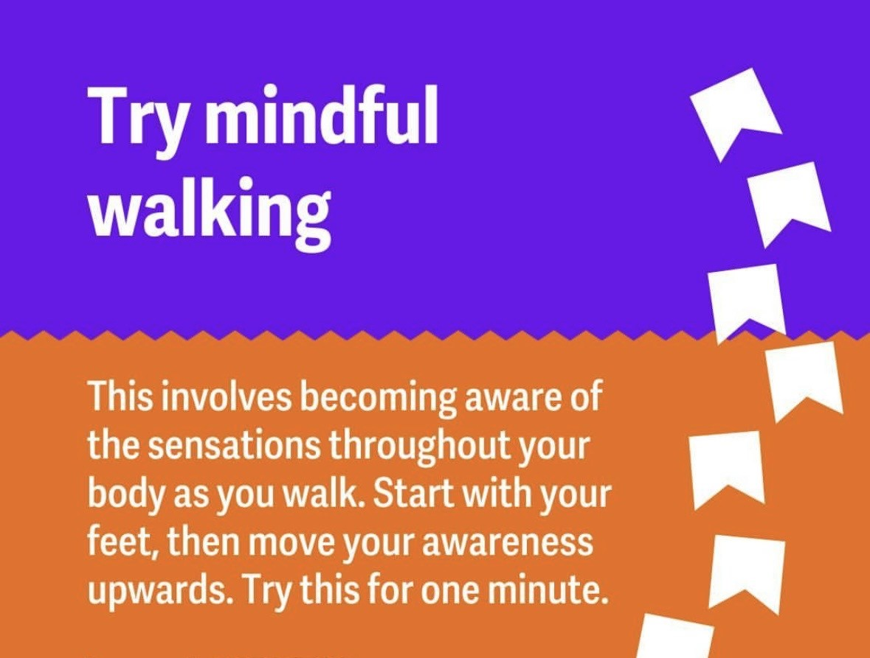
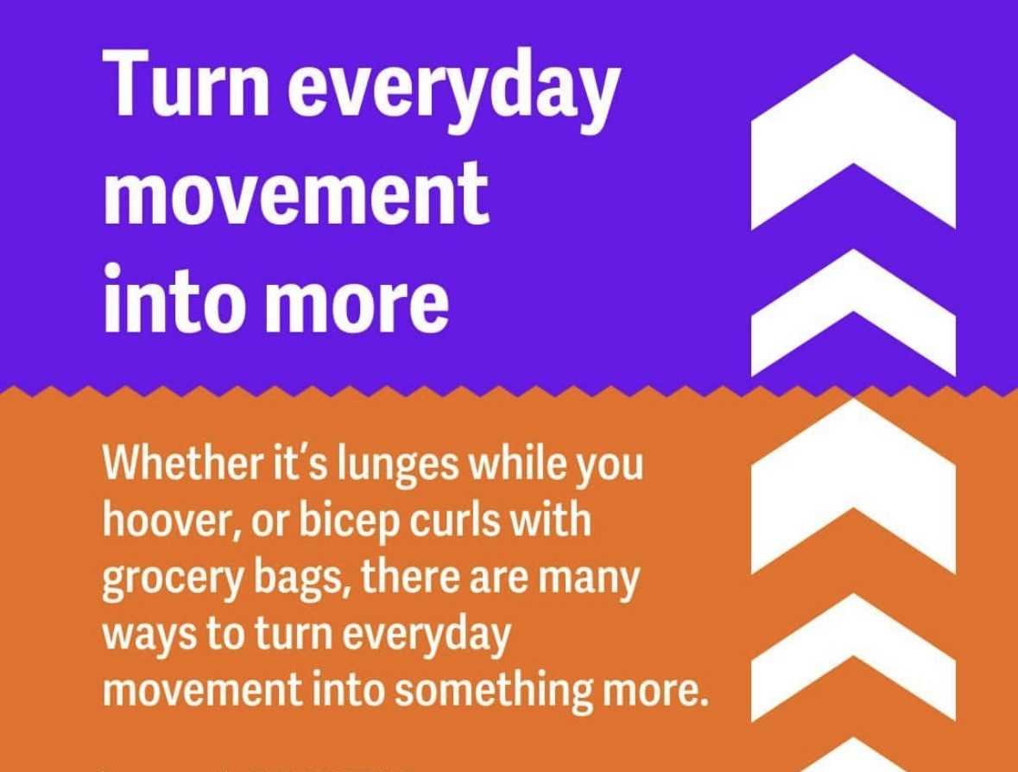
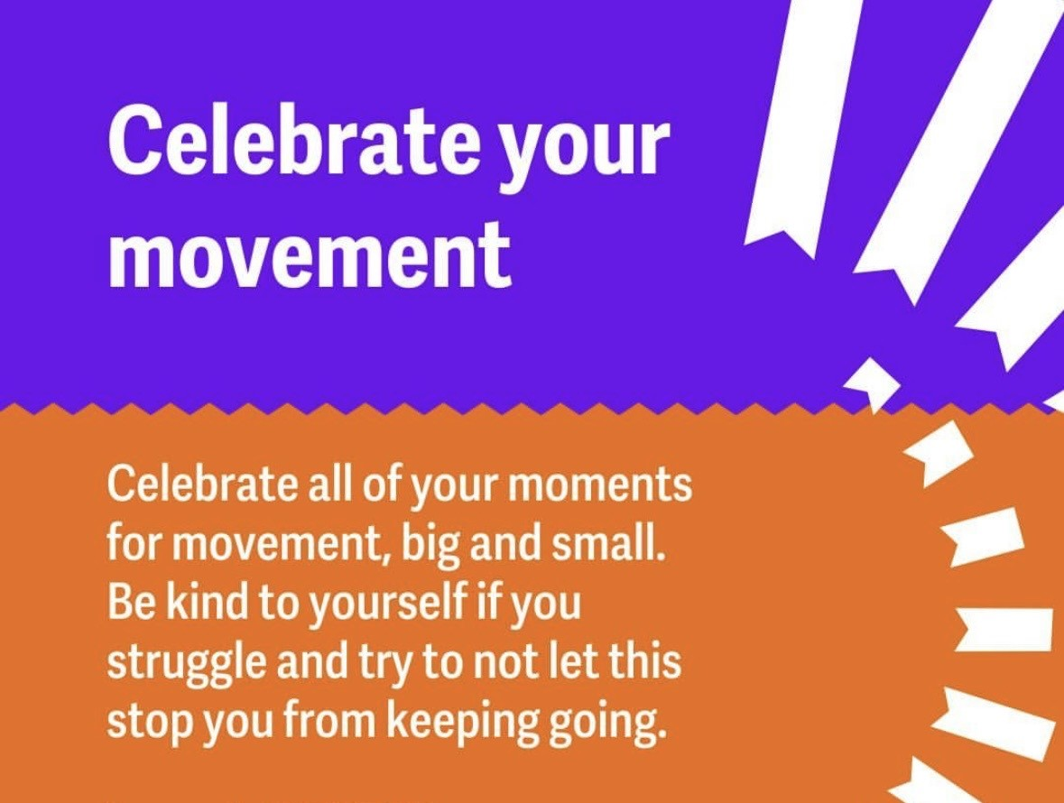
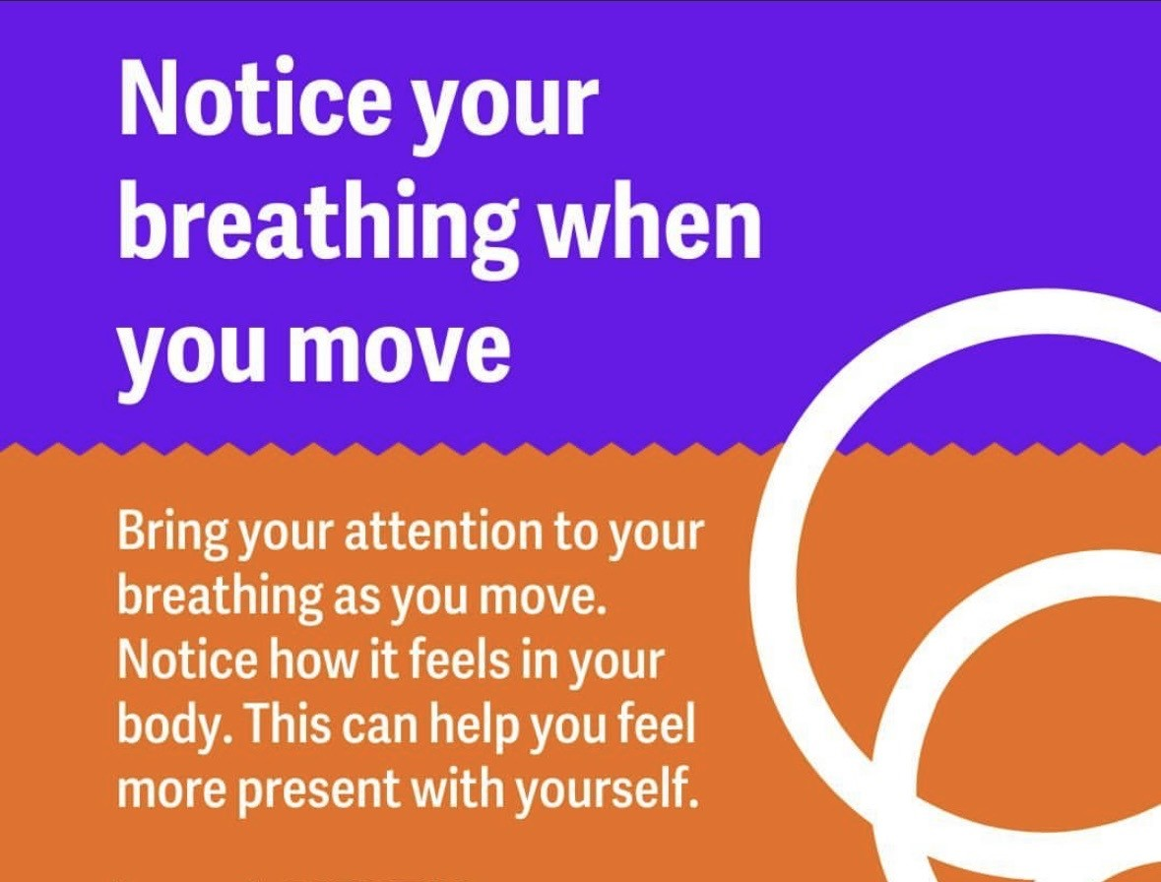
Notes:
Now that we have explored some aspects of mindful movement. Let's explore some emotional and psychological impact of opening up, specifically for men. This month we are focusing on men as studies show that men are less likely to open up emotionally or release through tears.

Slide 5
Exploring vulnerability for men - Quiz
Question #1:
What percentage of men experience a mental health disorder each year?
3%
8%
13%
20%
Response: 13% some of the most common mental health disorders include, depression, anxiety, PTSD, bipolar disorder and ADHD. Many researchers believe that men tend to underreport mental health symptoms which may lead to lower rates being reported.
Question #2:
How often do men cry each month?
2
1
10
20+
Cry? Men don’t cry
Response: 2 times- the average American man cries about 1.9 times each month. The average American woman cries 3.5 times each month.

Slide 6
Exploring vulnerability for men - Quiz
Question #3:
Men are more likely to die by suicide than women?
True
False
It’s about equal
Response: True- statistics consistently show the number of deaths by suicide for men are 4 times higher than women. In 2022, in the US, there were 40,000 suicide deaths in males and 10,000 suicide deaths in women.
Question #4:
What percentage of people feel better after crying?
2%
90%
50%
0%- crying doesn’t help

Slide 7
Is crying healthy for men?
Is It Okay for Men to Cry? Psychologists have established that emotional crying releases oxytocin and opioids that is released from within, more commonly known as endorphins. These are effectively the brain's feel-good chemicals that can help ease the physical and emotional pain caused by a situation.
Notes:
I will now pass it on to Jennifer who will walk us through the biological and physical impacts of crying and trauma.

Slide 8
What is the biological purpose of crying?
Tears produced by emotional experiences (unlike tears produced from cutting onions, yawning) lead to a reduction in cortisol (the stress hormone), which positively impact one's mood​
Evolutionary scientists believe that humans developed emotional crying to serve a social function. These theorists suggest that crying provides a visual (and sometimes auditory) signal to nearby people that you are in need of social support and nurturing
Crying, in the traditional sense, is a uniquely human phenomena. Humans are the only animals to shed tears in response to strong emotional experiences

Slide 9
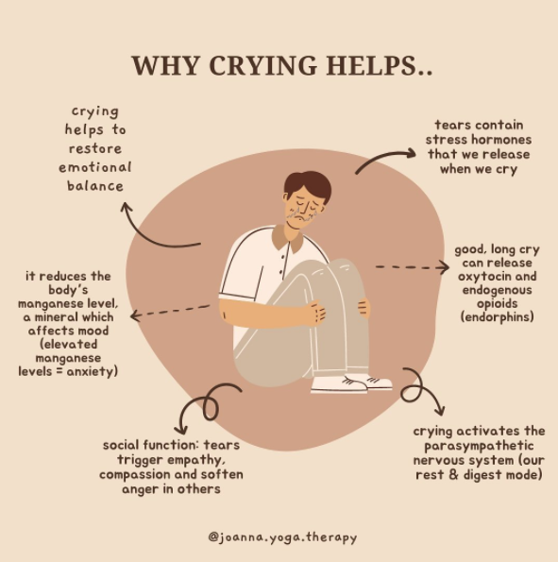

Slide 10
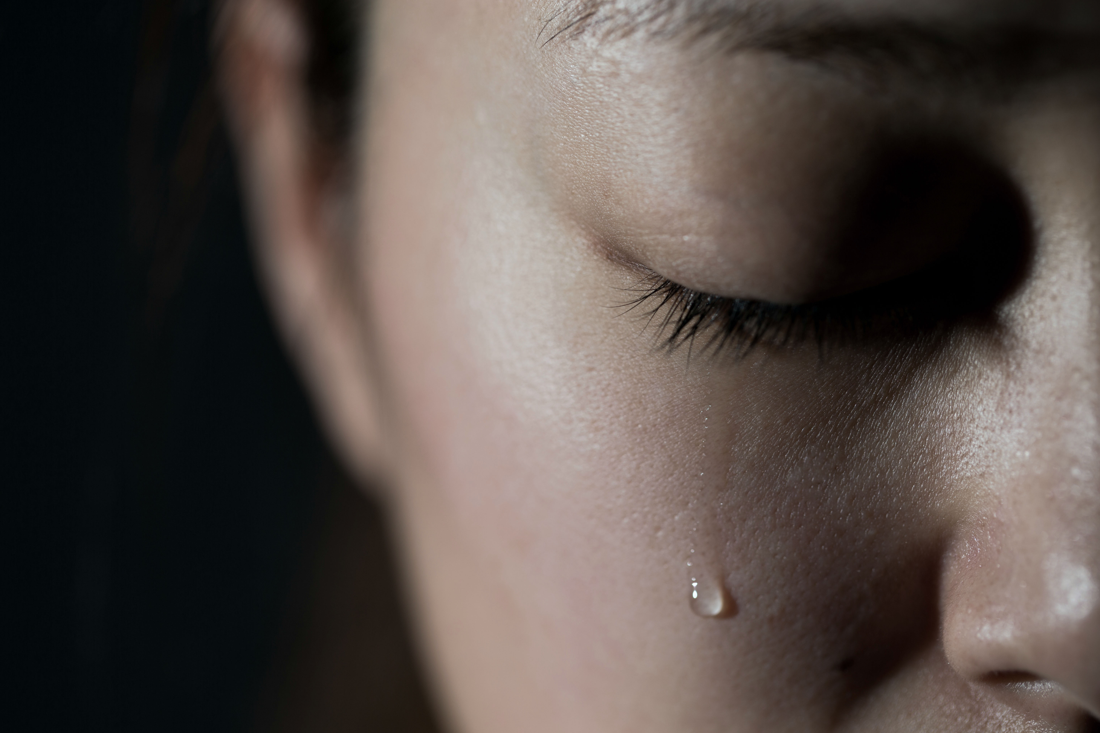
Is it better to cry to release or suppress it?
Today's psychological thought largely concurs, emphasizing the role of crying as a coping mechanism that allows us to release stress and emotional pain.
Crying is an important safety valve, largely because keeping difficult feelings inside, what psychologists call repressive coping, can be bad for our health

Slide 11
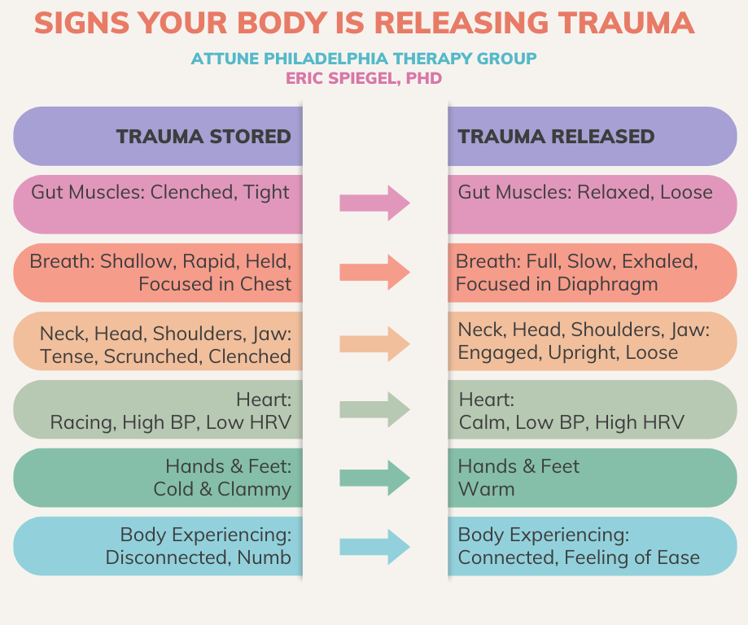
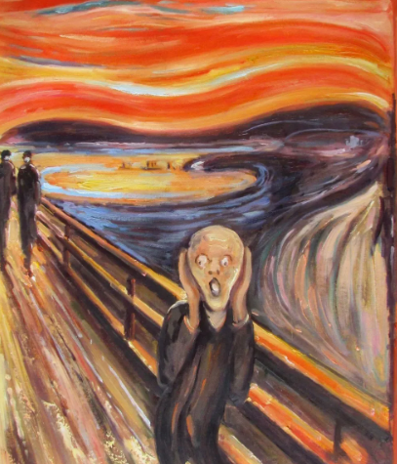
What are physical signs your body is releasing trauma?

Slide 12
